Slide 1
PRACTICES in SOFTWARE CONFIGURATION MANAGEMENT
Suvetha Selvaraju

Slide 2
Agenda
Configuration Management
SCM Process
Version Control
Baselines
SCM Practices
Benefits of SCM

Slide 3
Configuration Management
Configuration management (CM) is the discipline of identifying the configuration of a system at distinct points in time for the purpose of systematically controlling changes to the configuration, and maintaining the integrity and traceability of the configuration throughout the system life cycle.

Slide 4
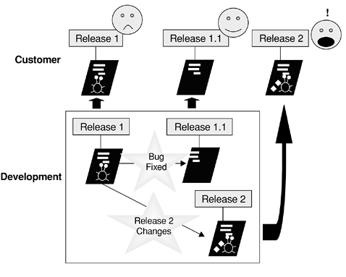

Slide 5
Reasons for changes in S/W
Changes in user requirements
Reengineering
Error detection
Adaptation to new technology
PROBLEMS:
Double Maintenance
Simultaneous Update

Slide 6
A software has been sold to many customers. For each customer, customization has been done and defects fixed during acceptance testing. Now a bug is detected in the base version and the product manager is trying to fix it for all the customers
Double Maintenance
Person A has made a copy of he program to fix some bug. Without knowing that Person B also has made the same copy of the program to find some bug
Simultaneous Update
The customer wants the software to meet the new conditions set by its regulatory body for its audit
Change in user Requirements
The customer wants the software to work for its new version of database
Adaptation to new technology

Slide 7
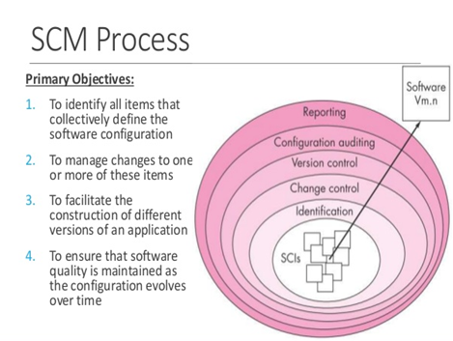
SCM Process
The SCM process defines a series of tasks:
Configuration Identification
Version Control
Change Control
Configuration Audit
Reporting

Slide 8
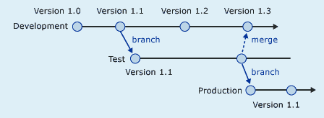
Version Control
Used to keep track of various versions of software to access it easily.

Slide 9
Version Mapping
It is a identification scheme to find out version number
One of the method is m.n
Used to understand and support a particular version of a software product
It provide the information to build a software product

Slide 10
Version Control System
The core mission of a version control system is to enable collaborative editing and sharing of data.
File sharing is the most common problem faced by all version control systems, so most of the systems use Version Control with Subversion.
For this the solutions can be:
-> Lock-Modify-Unlock Solution
->Copy-Modify-Merge Solution

Slide 11
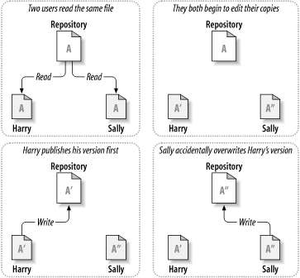
Problem of file sharing

Slide 12
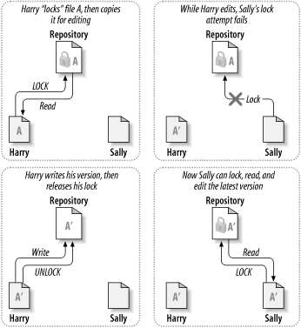
LOCK-MODIFY-UNLOCK SOLUTION

Slide 13
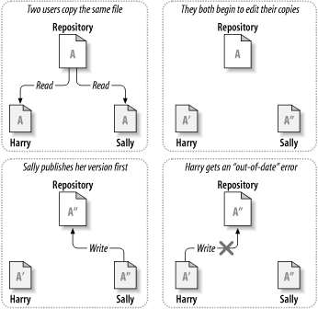
COPY-MODIFY-MERGE SOLUTION

Slide 14
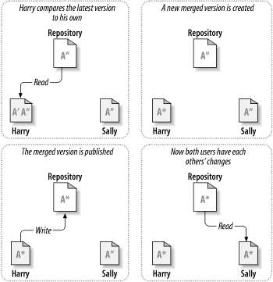

Slide 15
Baselines
The baseline is a point of reference.
Baseline is the value or condition against which all future measurements will be compared.
In Project management there are three baselines
Schedule baseline
Cost baseline
Scope baseline

Slide 16
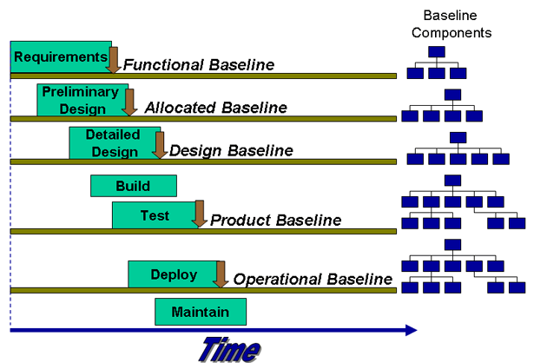

Slide 17
SCM Practices
Identify and store artifacts in a secure repository.
Control and audit changes to artifacts.
Organize versioned artifacts into versioned components.
Organize versioned components and subsystems into versioned subsystems.
Create baselines at project milestones.

Slide 18
Record and track requests for change.
Maintain stable and consistent workspaces.
Support concurrent changes to artifacts and components.
Integrate early and often.
Ensure reproducibility of software builds.

Slide 19
Benefits of SCM
Thus SCM is very much important for effective project maintenance
Since changes are constant it should be effectively monitored
Without SCM project will lead to failure and affect the profit of the organization.
SCM Benefits the Organization in Four Major Ways
->Control
->Management
->Cost
->Quality
“CHANGES ARE ALWAYS CONSTANT”

Slide 20
THANK YOU…..

